Slide 1

Setting Media Query Rules for Responsive Design
Group Members:
Zainab Elmukashfi Ali Musa
Dushime Nani Chris
Mulungi Martha

Slide 2
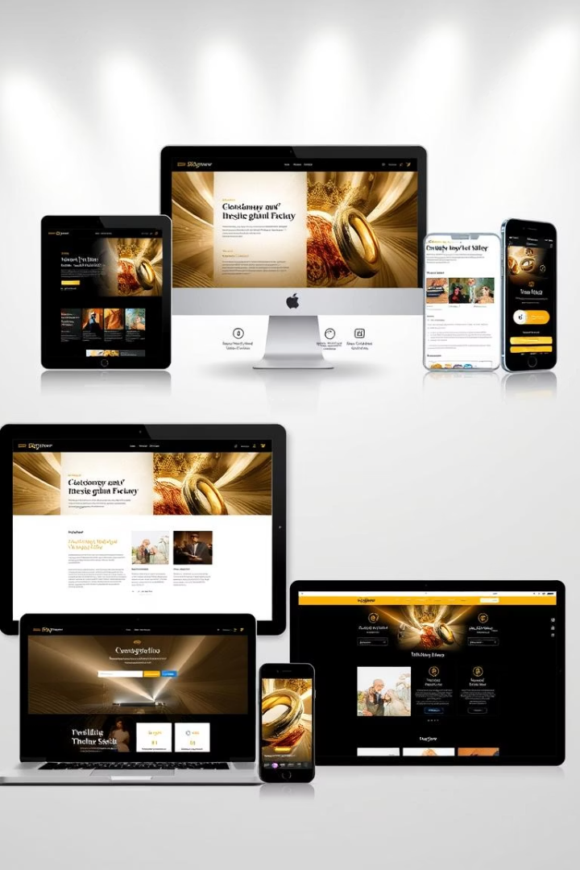
Setting Media Query Rules for Responsive Design
This presentation explains CSS media queries and their role in responsive web design.
Learn how to adapt websites for different screen sizes and devices effectively.

Slide 3

What Are Media Queries?
Definition
Purpose
CSS rules enabling style changes based on device features.
Make websites adapt to screen size and device type.
Impact
Essential for building responsive and user-friendly sites.

Slide 4

Why Use Media Queries?
Device Adaptation
Layout Control
Optimize website appearance across phones, tablets, and desktops.
Adjust layouts, fonts, and colors to enhance readability.
User Experience
Ensure seamless usability and accessibility on all devices.

Slide 5
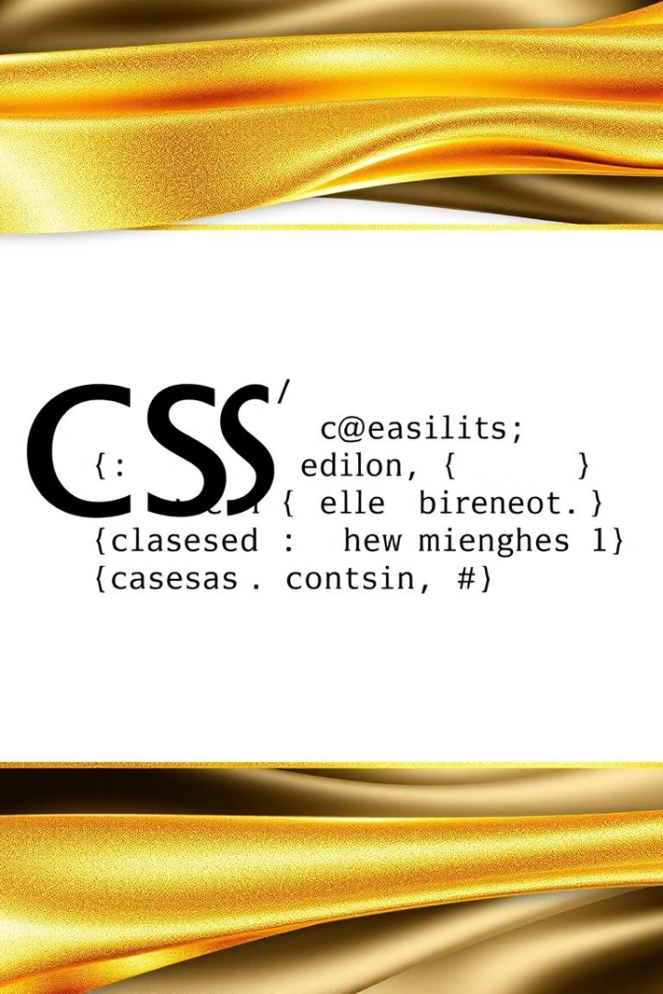



Basic Media Query Syntax
@media Keyword
Starts the media query rule
Condition
Defines devices or screen sizes in parentheses
CSS Rules
Styling applied when conditions are true

Slide 6
Example 1: Styling for Small Screens
Code
Effect
@media (max-width: 600px) { body { background-color: lightblue; } }
Sets background color for phones and smaller devices

Slide 7
Example 2: Styling for Larger Screens
Code
Effect
@media (min-width: 768px) { p { font-size: 18px; } }
Increases font size on tablets and larger devices

Slide 8

Media Query Conditions and Devices
Device Type
Screen Width
Mobile Phones
max-width: 600px
Tablets
601px to 900px
Laptops & Desktops
901px and up
Large Screens or TVs
Above desktop widths

Slide 9

Summary: Media Queries for Responsive Design
Test Across Devices
Design Responsively
Verify appearance and function on phones, tablets, and more.
Apply @media Rules
Adjust styles dynamically for an optimal user experience.
Use conditions like max-width or min-width to target devices.

